Slide 1
Global threats, repercussions, and opportunities for advancement
Robert Wood
Principal Economist,
Latin America and the Caribbean
GLOBAL FORUM LATIN AMERICA AND THE CARIBBEAN 2022
New York
September 2022

Slide 2
Russia-Ukraine
What next?

Slide 3
Five scenarios for what next?
Scenario #1 - Russia seizes eastern and southern Ukraine:
Russia defeats Ukraine and coerces the government to accept its demands, including a partition of the country.
Large swathe of Ukrainian territory falls under Russian control.
Scenario #2 - A negotiated end of the war:
Russia and Ukraine negotiate to end the war, with Russia achieving some of its aims (but what are these, exactly?).
Ukraine suffers permanent curtailment of its sovereignty.
Scenario #3 - A humiliating Russian defeat:
Russia faces major setbacks, large casualties and military disarray, owing to fierce Ukrainian resistance and Western arms.
Humiliating retreat eastwards and regime change in Russia.
Scenario #4 - Russia establishes a puppet government:
Russia overthrows the Ukrainian government and establishes a puppet government in Ukraine.
Russia gets dragged into long war, resistance from Ukrainians.
Scenario #5 - NATO gets dragged in the conflict:
Chain of events (eg. no-fly-zone, cyberattacks, miscalculation) draws NATO in the Ukrainian conflict.
Global war follows. Nuclear option unlikely, but not impossible.

Slide 4
Beyond war in Ukraine - Six key global themes
Coronavirus vaccines
Supply chains issues
Rising global inflation
How will we vaccinate the rest of the world?
When will disruptions (finally) come to an end?
Is the sky the only limit?
Could resulting interest rate hikes spark a debt crisis?
Climate change
Tech & chips
Taiwan
Are we on track to meet the climate change challenge?
It’s all about reshoring and decoupling
What are China’s plans around the island?

Slide 5
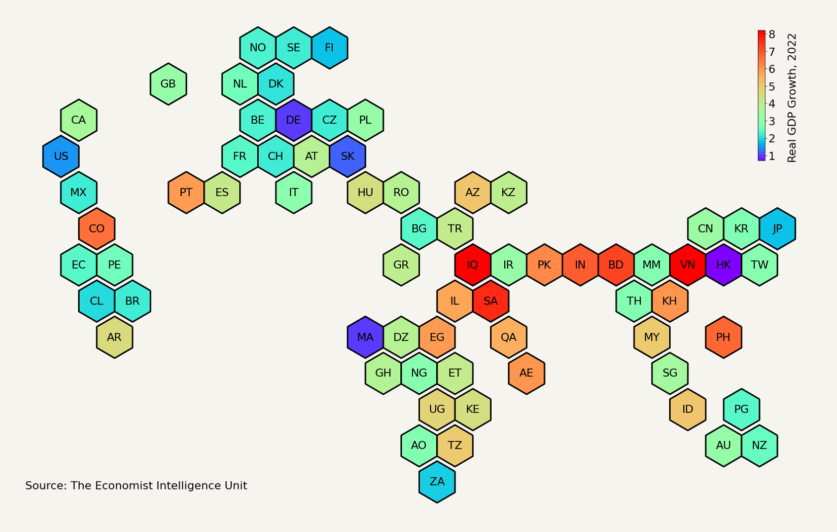
Global growth of 2.6% in 2022 - down from 3.9% before war started
High inflation and Fed tightening are biting in US (1.5% growth)
UK still in recovery mode (3.2%)
Recessions in Russia (-6.2%), Ukraine (-36%)
Zero-covid, power shortages, droughts, property sector woes severely weighing on growth in China (3.3%)
UA
Eastern Europe is most affected in euro zone
MEA commodity exporters will benefit from higher prices
China-induced drag on growth in Asia
LatAm will suffer from high inflation, but rising commodities prices beneficial to some states

Slide 6
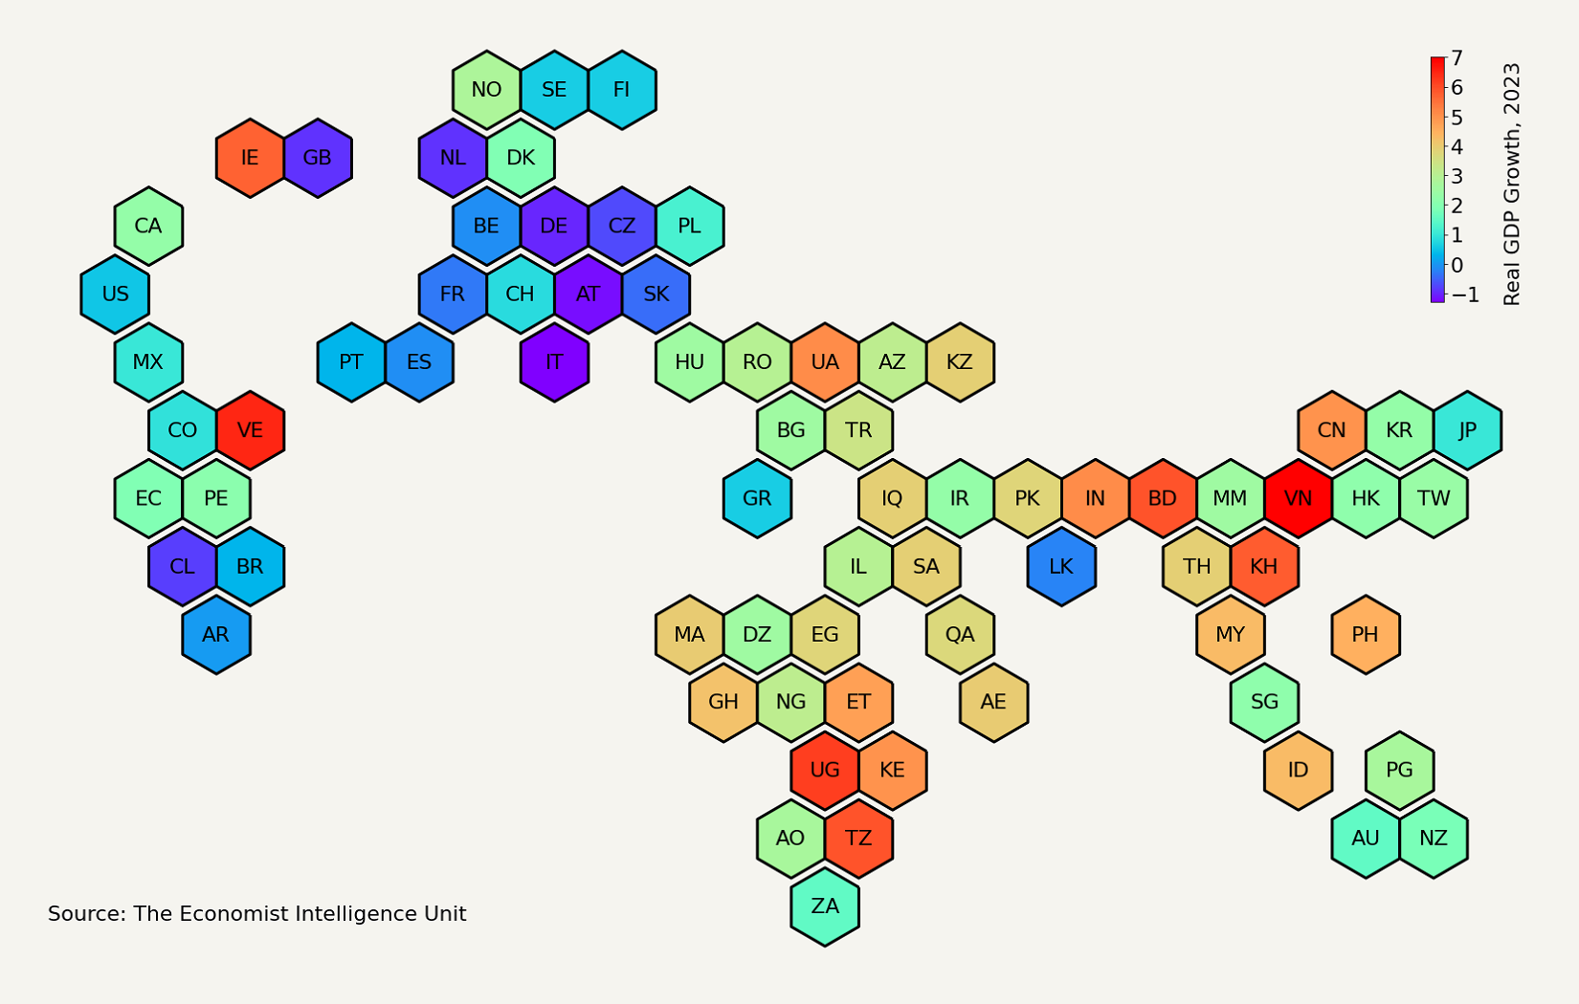
Things will get (much) worse in 2023, with global growth of only 1.7%
Technical recession in US (0.5% growth)
China will post modest rebound after 2022 slump (5% growth)
RU
Recession ahead in euro zone (-0.4%)
Slowdown in growth in US, euro zone and China will be a drag on growth elsewhere in the world

Slide 7
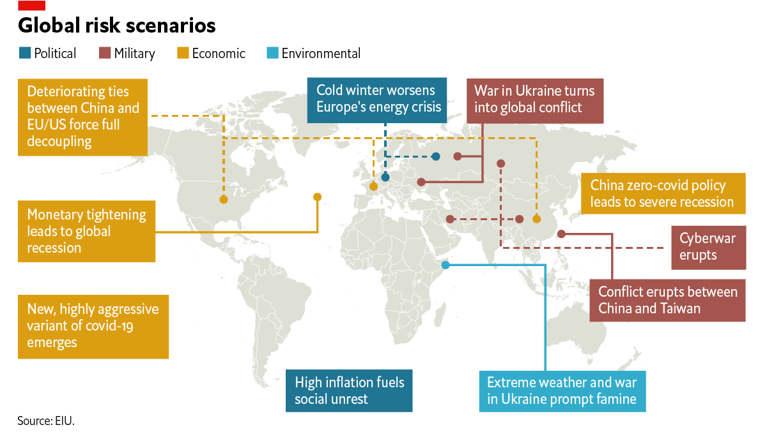
What are the top ten risks for the global economy?

Slide 8
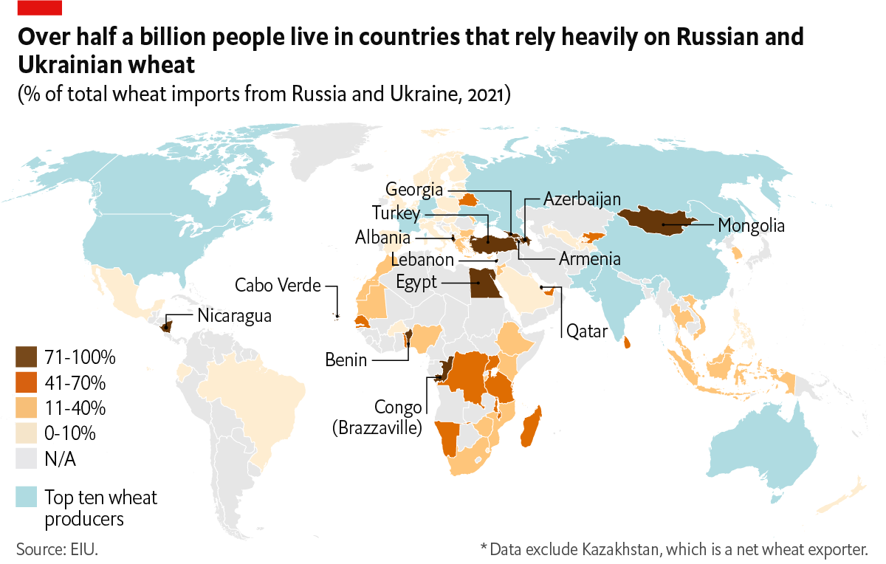
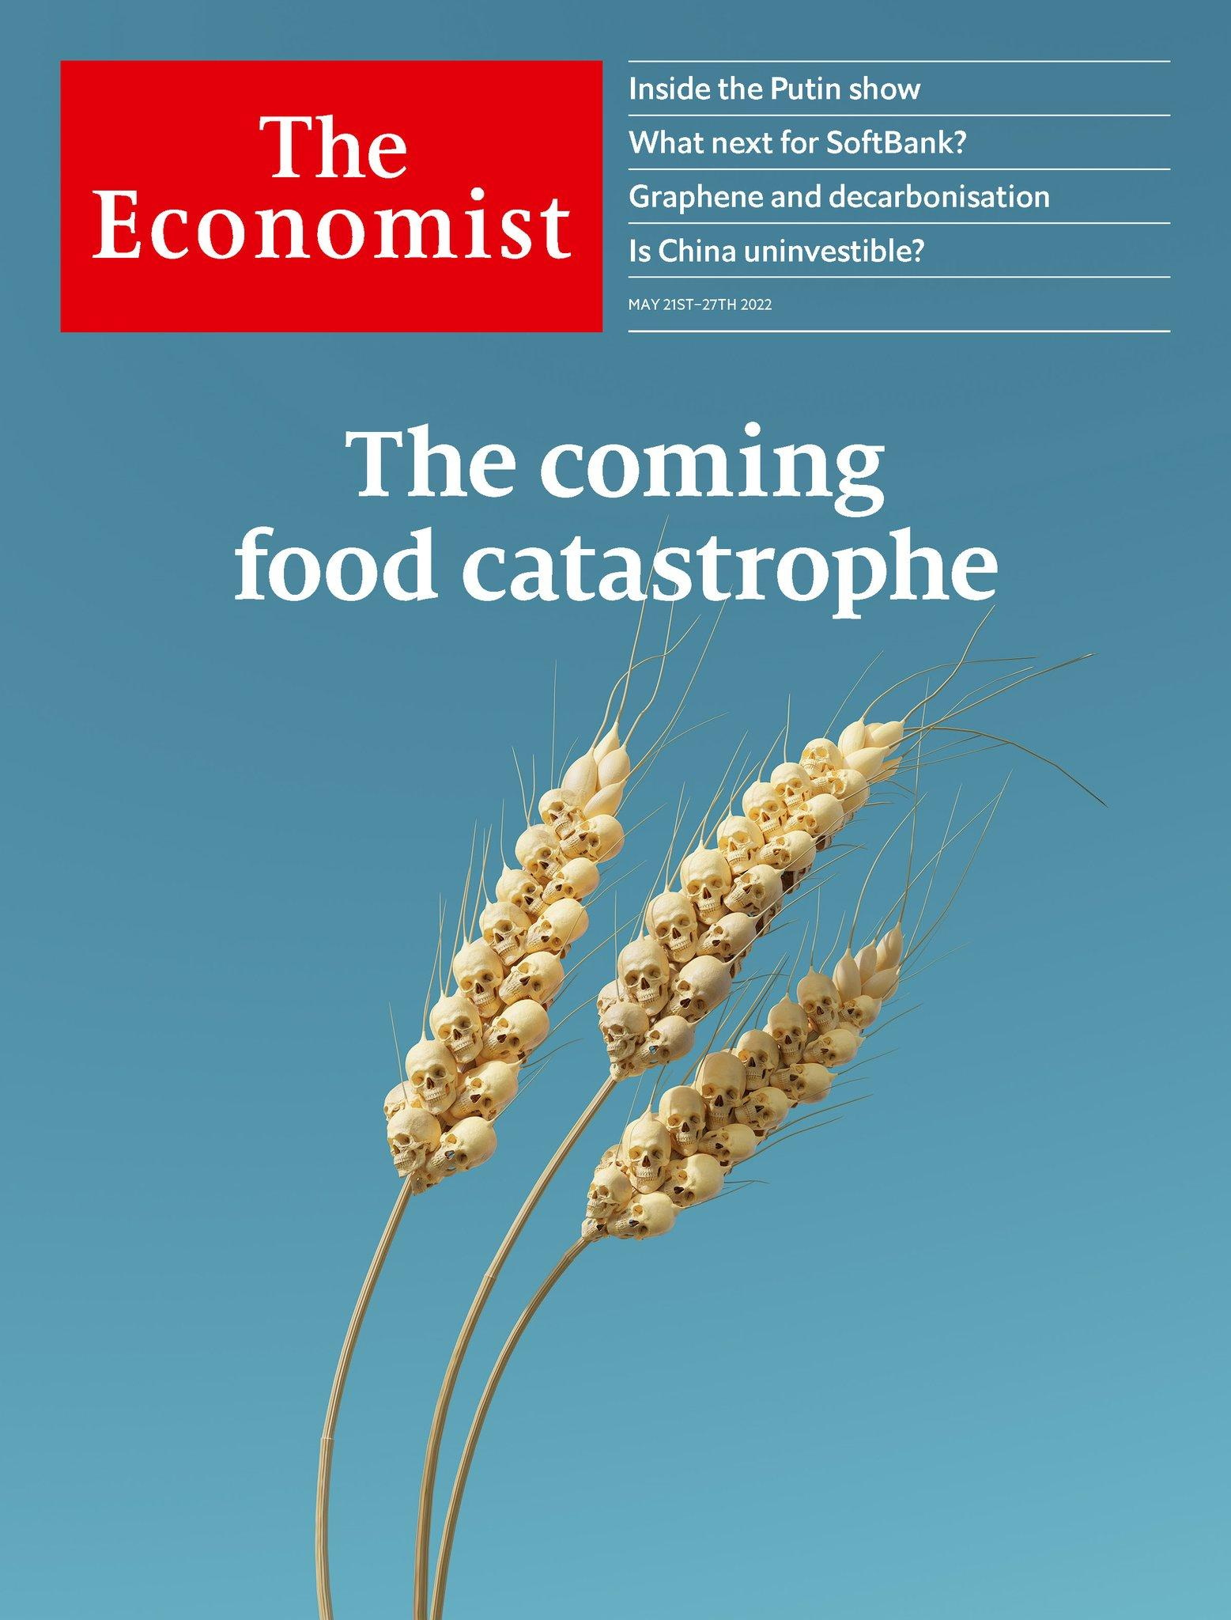
Should we worry about food insecurity (this year)?

Slide 9
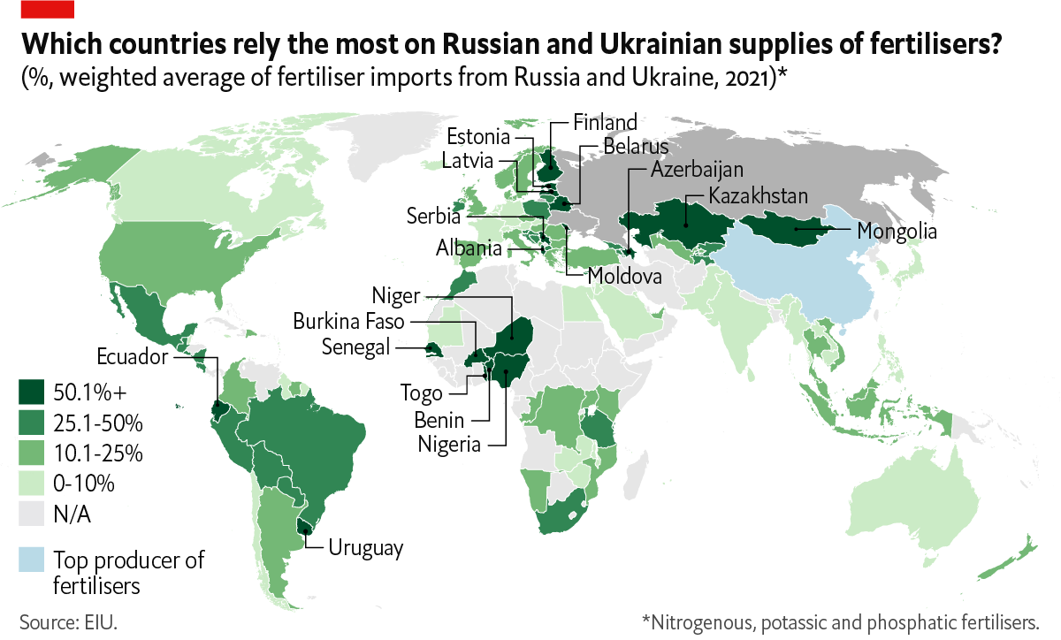
Should we worry about food insecurity (next year)?

Slide 10
Five ways coronavirus and war in Ukraine are changing business
New push for defence spending
Weaponisation of finance deepens
Green transition continues to diverge
NATO has new raison d’être
Defence comes back to headlines
Opportunity: increased funding for defence sector
Russia and China look for alternative payment systems
Opportunity: collaboration on sanctions/fintech
Developed: renewables push
Developing: relying on fossil fuels
Opportunity: co-operation on cross-border green projects
Tech continues to become (geo-)political
Commodities are back on the agenda
Tech supply chains as a competitive advantage—weapon
Opportunity: reshoring microchip production to Europe
Increasing food insecurity
Higher commodities prices
Opportunity: co-operation on food tech and resilience of supply
These trends are not new, but the pandemic and the war in Ukraine are turbocharging them.

